Slide 1

Data Cleaning & Tidy Data

Slide 2
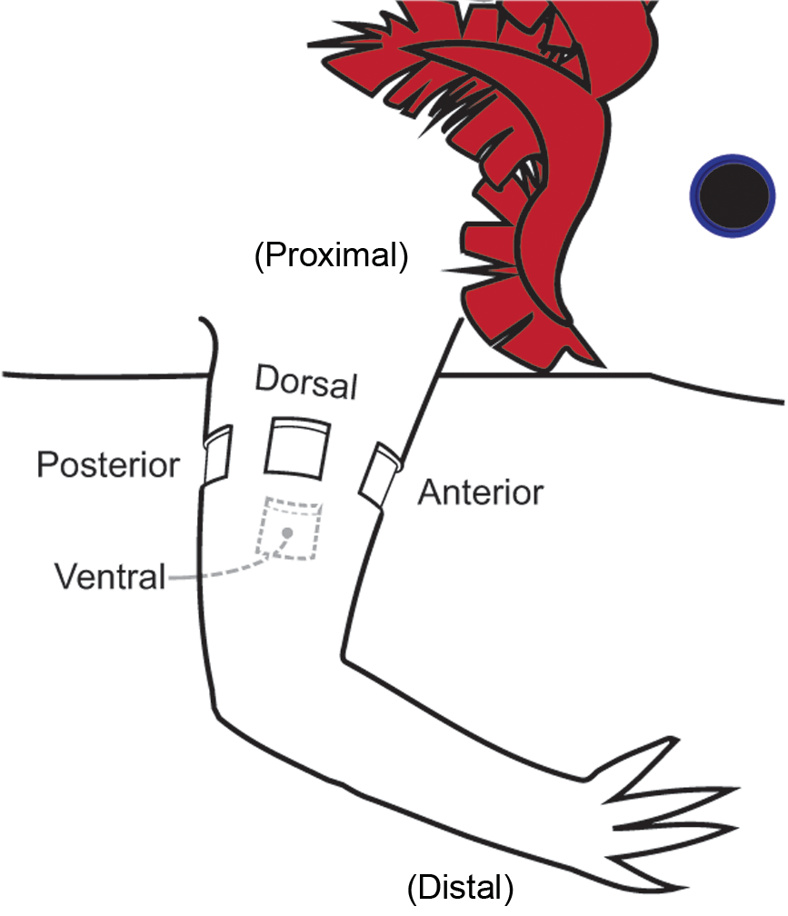
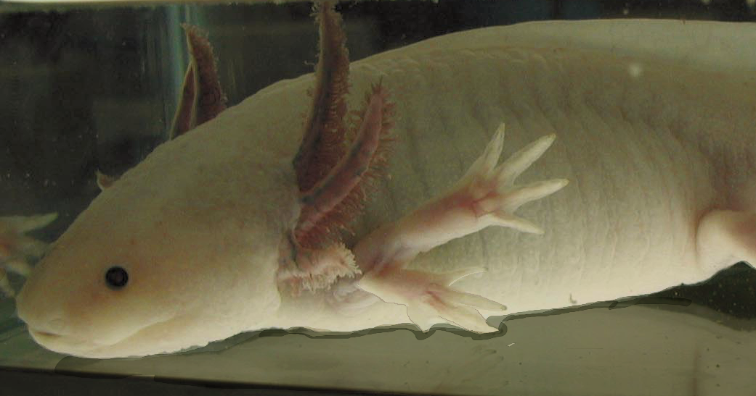
Requirements for Amphibian Limb Regeneration
1. Generate a wound epithelium
2. Innervate the wound epithelium
3. Establish a positional disparity
(Endo Dev Bio, 2004)
Notes:
In the third step of a regenerative response, limb cells from different positions on the limb (ex A/P or D/V) interact and communicate information about their original position. This generates a “positional disparity’ which results in the formation of a new limb field… and the formation of new limb structures.
For example, if we graft posterior skin into an innervated wound on the anterior side of the limb, the resulting positional disparity generates a new limb field on the side of the limb…
Summarize each step…

Slide 3
Example image of a whole mount cartilage/bone stain on a limb where I performed the ALM surgery
Ectopic limb formed in
Site of ALM surgery… cool/weird huh?!

Slide 5
Loading and initial chopping
What is the optimal way to load the data and get row titles?
Chop extra rows/cols
Standardize text
Find bad rows using regular expressions

Slide 6
Beyond == for Strings
How do I match which strings have an e in them?
c(“hello”, “goodbye”, “salutations”)

Slide 7
Beyond == for Strings
> hello <- c("hello", "goodbye", "salutations")
> grep("e", hello)
[1] 1 2

Slide 8
Beyond == for Strings
> hello <- c("hello", "goodbye", "salutations")
> grepl("e", hello)
[1] TRUE TRUE FALSE
Exercise - which of these have the letter l in them?

Slide 9
Matching Patters with REGEXP
Which of these have an “o” not at the end of the line?
c(“hello”, “goodbye”, “salutations”)
grepl(“o.", hello)

Slide 10

Whither the ‘.’
. matches any character
It is a metacharacter – there are many!
xkcd

Slide 11
Some General Regexps
. - any character apart from a newline.
\\d - any digit.
\\s - any whitespace (space, tab, newline).
\n – a line break
[abc] - match a, b, or c.
[!abc] - match anything except a, b, or c.
Which of these have a digit-space combo?
c(“33 points”, “hello kitty”, “drove up 95”)

Slide 12
Line start and End
Which of these have an “o” not at the end of the line?
c(“hello”, “goodbye”, “salutations”)
!grepl(”o$", hello)
^ - Start of line, $ - end of line

Slide 13
But what if I want to find $
Escape characters allow you to ignore special meaning of $, ^, or other metacharacters
\\$ finds $
\\\ finds \
\\( finds (

Slide 14
Multiple Letters
Which of these have a double l?
c(“hello”, “goodbye”, “salutations”)
grepl(”ll", hello)
grepl(”l{2,}", hello)

Slide 15
Modifiers for Multiples
? - 0 or 1
+ - 1 or more
* - 0 or more
{n} - exactly n
{n,} - n or more
{,m} - at most m
{n,m} - between n and m

Slide 16
Exercise
Which of these have at least 1 number?
Which have 2 or more numbers?
Which have >2 numbers?
c("green 5", "blue 32", "blue 32", "hut hut", "2348923”)

Slide 17
Stump Us!
Using http://bit.ly/regexp-cheat come up with a devilish regexp problem for us
When you’ve got it, share it, and we’ll try and solve it

Slide 18
Regexp and Filter
How would you use Regexps to filter out bad rows in the Axoltl data?

Slide 19
Substitution
Regexps can be most useful in changing text
Pattern
Replacement
> gsub("hello", "ciao", hello)
[1] "ciao" "goodbye" "salutations"

Slide 20
Exercise
Use Substitution to clear out values from cells that have “completed” text in them

Slide 21
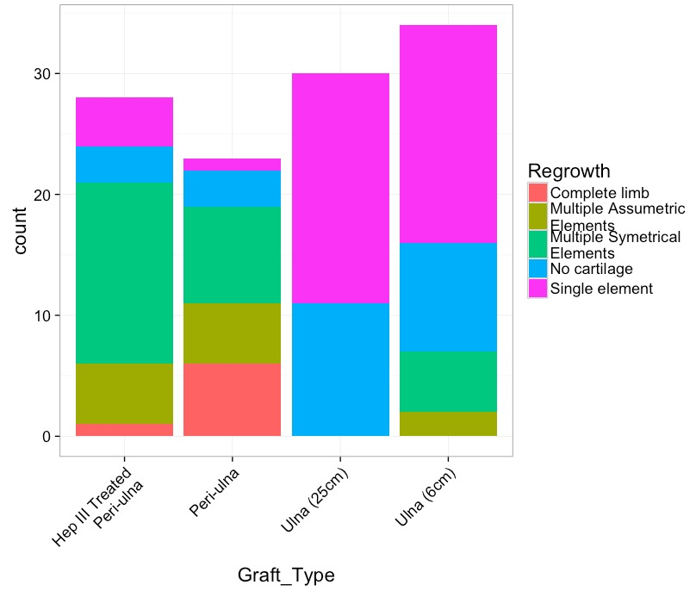
Use Substitution to Simplify Text

Slide 22
Extracting Pieces
> gsub("^(\\w*) (.*)",
"\\1",
"Are you a string?")
[1] "Are"
Just the first ()

Slide 23
Extracting Pieces
> gsub("^(\\w*) (.*)",
"\\2",
"Are you a string?")
[1] "you a string?"

Slide 24
Fill down
> adf <- data.frame(x = c(1,NA, NA, NA, 3, NA, NA, NA))
> adf
x
1 1
2 NA
3 NA
4 NA
5 3
6 NA
7 NA
8 NA

Slide 25
Fill down
library(tidyr)
adf %>%
fill(x, .direction="down")
x
1 1
2 1
3 1
4 1
5 3
6 3
7 3
8 3
Try this with the EXPERIMENT column

